Slide 1
Chapter 5.
Models for Nonstationary Time Series
5.1 Stationarity Through Differencing
5.2 ARIMA Models
5.3 Constant Terms in ARIMA Models
5.4 Other Transformations

Slide 2
5.1 Stationarity Through Differencing
Exhibit 5.1 shows the monthly price of a barrel of crude oil from January 1986 through January 2006. The series displays considerable variation, especially since 2001, and a stationary model does not seem reasonable.

Slide 3
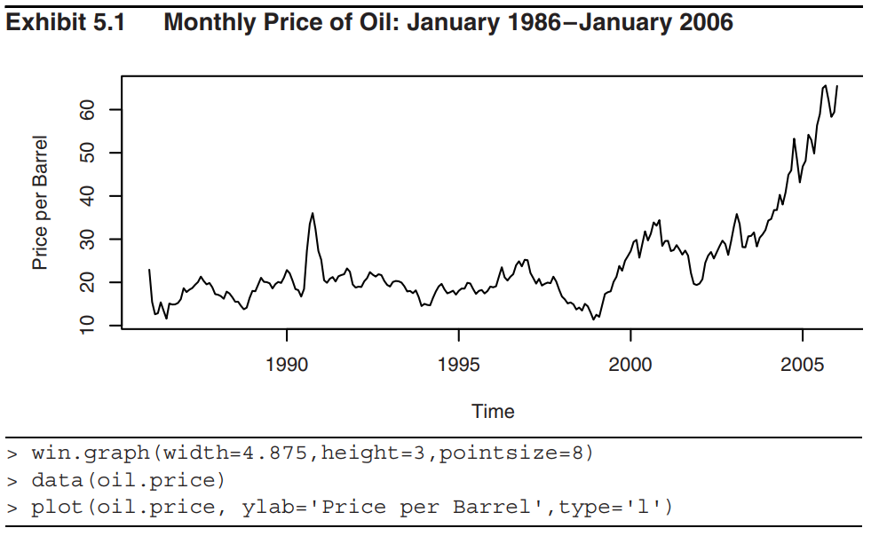
5.1 Stationarity Through Differencing

Slide 4
5.1 Stationarity Through Differencing
Consider an AR(1) model
Y_{t} = φ Y_{t−1} + e_{t} (5.1.1)
where e_{t} is a true “innovation” (that is, e_{t} is uncorrelated with Y_{t–1}, Y_{t–2}, …).
In Chapter 4, (5.1.1) is stationary if and only if |φ| < 1. Now, we consider the case of |φ| ≥ 1. In particular,
Y_{t} = 3 Y_{t−1} + e_{t} (5.1.2)

Slide 5
5.1 Stationarity Through Differencing
Iterating into the past, we obtain
We see that the influence of distant past values of Y_{t} and e_{t} does not die out – indeed, the weights applied to Y₀ and e₁ grows exponentially large.
Assume e_{t} follows a standard normal distribution and
Y₀ = 0. We have the following simulated values
t | 1 | 2 | 3 | 4 | 5 | 6 | 7 | 8
e_{t} | 0.63 | −1.25 | 1.80 | 1.51 | 1.56 | 0.62 | 0.64 | −0.98
Y_{t} | 0.63 | 0.64 | 3.72 | 12.67 | 39.57 | 119.33 | 358.63 | 1074.91

Slide 6
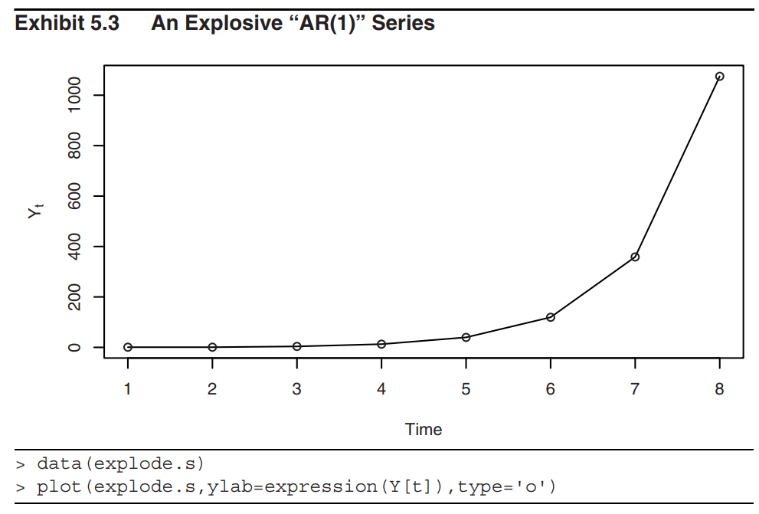
5.1 Stationarity Through Differencing

Slide 7
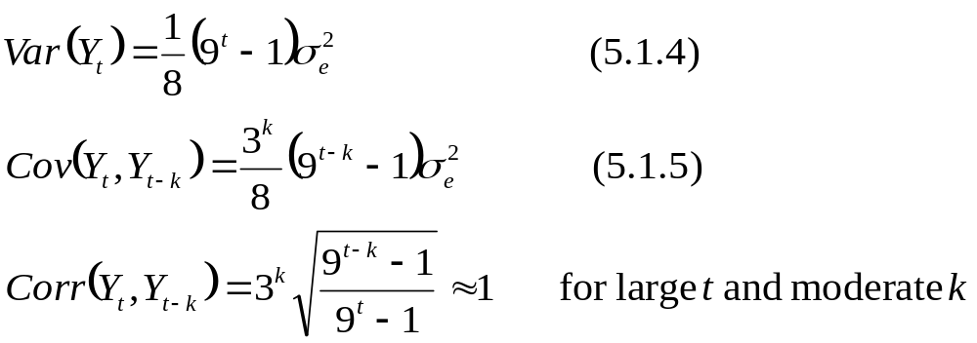
5.1 Stationarity Through Differencing
Eqs.(5.1.4) and (5.1.5) shows the explosive behavior of {Y_{t}} in Eq. (5.1.2).

Slide 8
5.1 Stationarity Through Differencing
If φ = 1, the AR(1) model equation is
Y_{t} = Y_{t−1} + e_{t} (5.1.6)
Clearly, (5.1.6) is not stationary. However,
∇Y_{t} = Y_{t} – Y_{t−1}= e_{t} (5.1.7)
is stationary.
Here, ∇Y_{t} is defined as the first difference of Y_{t}.

Slide 9
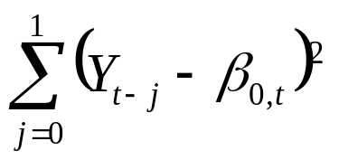
5.1 Stationarity Through Differencing
Suppose
Y_{t} = M_{t} + X_{t} (5.1.8)
where X_{t} is a stationary series with E[X_{t}] = 0 for all t.
Now, we consider several cases of M_{t} in which ∇Y_{t} is a stationary process.
First Difference
Case 1:
Assume M_{t} is approximately constant over every two consecutive time points, the estimate of M_{t} is the β_{0, t} that minimizes

Slide 10
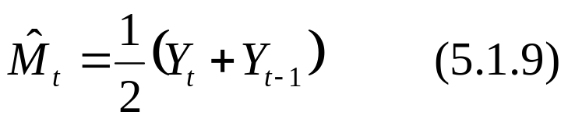
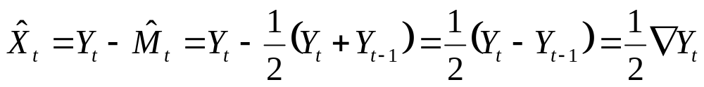
5.1 Stationarity Through Differencing
This clearly leads to
The “detrended” series (residual) at time t is then
Thus, (1/2)∇Y_{t} is a stationary process.

Slide 11
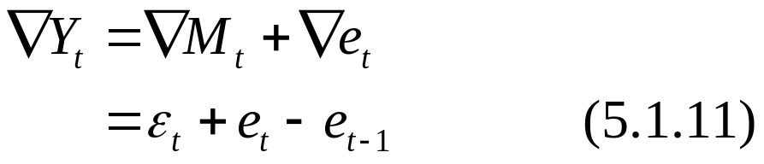
5.1 Stationarity Through Differencing
Case 2:
Assume M_{t} is stochastic and changes slowly over time governed by a random walk model. Suppose, for example, that
Y_{t} = M_{t} + e_{t} with M_{t} = M_{t–1} + ε_{t} (5.1.10)
where {e_{t}} and {ε_{t}} are independent white noise series.
Then
The autocorrelation functions of ∇Y_{t} in Eq. (5.1.11) is the same as the MA(1) series. So, {∇Y_{t}} is a stationary process.

Slide 12
5.1 Stationarity Through Differencing
Exhibit 5.4 displays the time series plot of the differences of logarithms of the oil price time series. The differenced series looks much more stationary when compared with the original series in Exhibit 5.1.

Slide 13
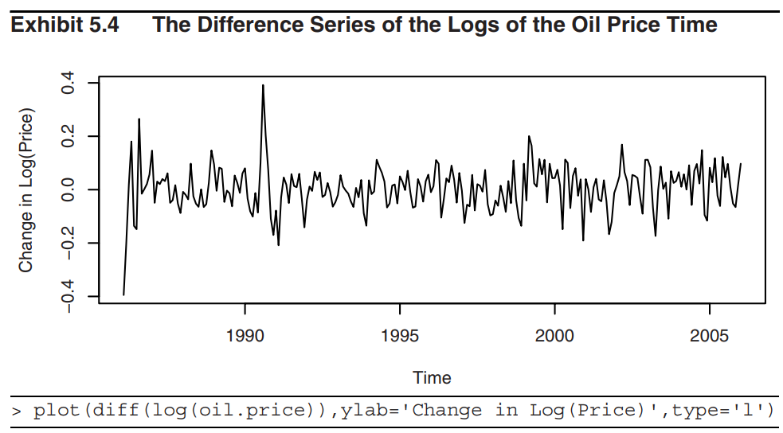
5.1 Stationarity Through Differencing

Slide 14
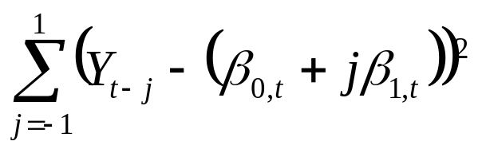
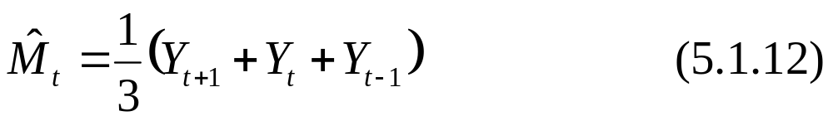
5.1 Stationarity Through Differencing
Second Difference
Case 1:
Assume that M_{t} is linear in time over three consecutive time points. We can now predict M_{t} at the middle time point t by choosing β_{0,t} and β _{1,t} to minimize
The solution yields

Slide 15
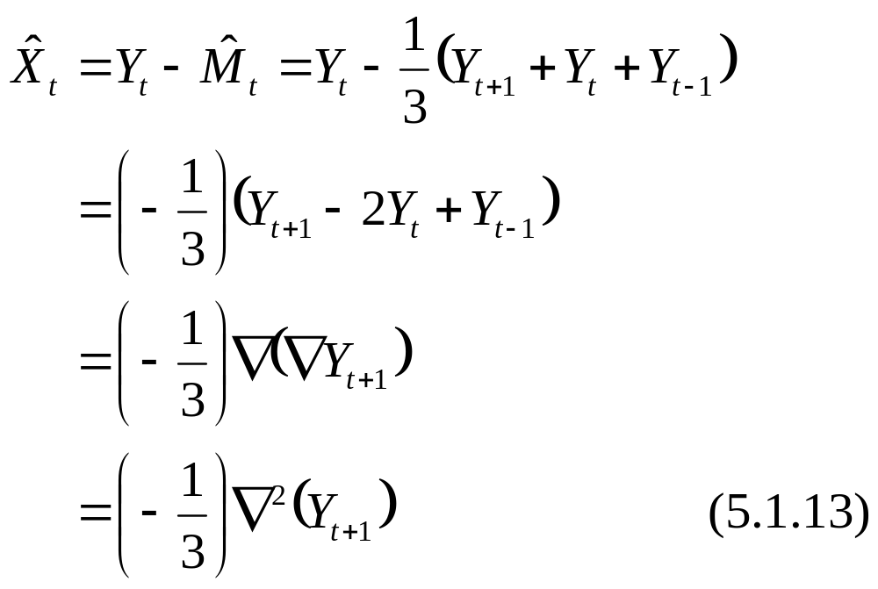
5.1 Stationarity Through Differencing
and thus the detrended series is
Thus, {∇² (Y_{t})} is a stationary process.

Slide 16
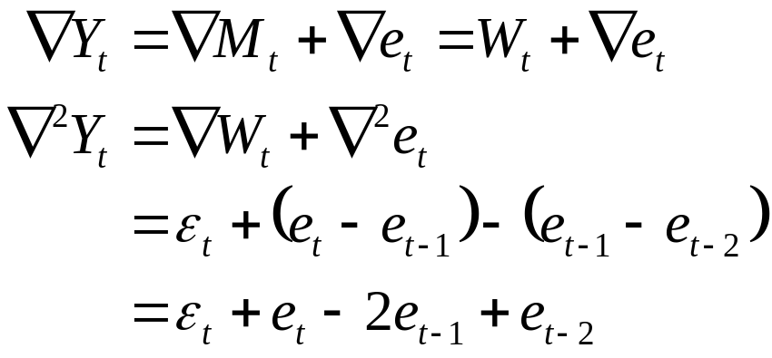
5.1 Stationarity Through Differencing
Case 2:
Assume that
where {e_{t}} and {ε_{t}} are independent white noise series.
Then
which has the autocorrelation function of an MA(2) process. Thus, the second difference of {Y_{t}} is stationary.

Slide 17
5.2 ARIMA Models
Definition
A time series {Y_{t}} is said to follow an integrated autoregressive moving average model if the dth difference W_{t} = ∇^{d}Y_{t} is a stationary ARMA process. If {W_{t}} follows an ARMA(p, q) model, we say that {Y_{t}} is an ARIMA(p, d, q) process.

Slide 18
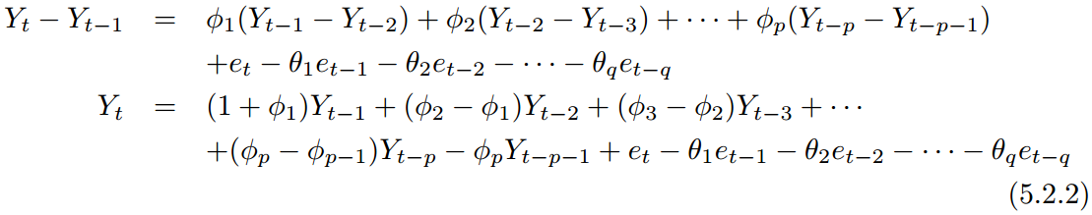
5.2 ARIMA Models
Consider an ARIMA(p, 1, q) process. With W_{t} = Y_{t} – Y_{t−1}, we have
or in term of an observed time series {Y_{t}},
We call this the difference equation form of the model.

Slide 19
5.2 ARIMA Models
It appears to be an ARMA(p + 1, q) process. The characteristic polynomial satisfies
It is clearly that x = 1 is one of the roots of the corresponding characteristic equation. Hence, the process {Y_{t}} is nonstationary. However, the remaining roots are the roots of the characteristic equation of the stationary process {W_{t}}.

Slide 20
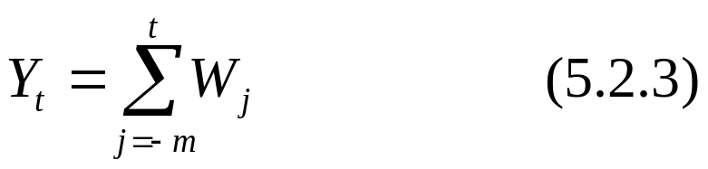
5.2 ARIMA Models
Since nonstationary processes are not in statistical equilibrium, we cannot assume that they can be represented by infinitely past of W_{t}, that is t starting from −∞.
However, we can assume that they start at some time point t = –m, say , where –m is earlier than time t = 1, at which point we first observed the series.
By summing both sides of the difference equation
Y_{t} – Y_{t – 1} = W_{t} and set Y_{t} = 0 for t < –m, we obtain
for the ARIMA(p, 1, q) process.

Slide 21
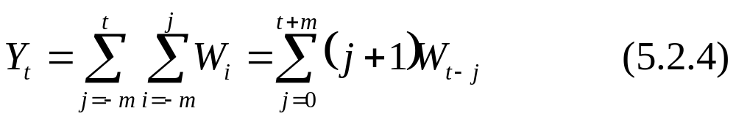
5.2 ARIMA Models
The ARIMA(p, 2, q) process can be dealt with similarly by summing twice to get the representations
Definition
Consider an ARIMA(p, d, q) process.
If p = 0 or the process contains no autoregressive terms, then it is called an integrated moving average (IMA(d, q)).
If q = 0 or the process contains no moving average terms, then it is called an autoregressive integrated (ARI(p, d)).

Slide 22

5.2 ARIMA Models
The IMA(1, 1) Model
The difference equation form of the IMA(1, 1) model is given by
In terms of present and past noise values, we use Eq. (5.2.3) and the fact that W_{t} = e_{t} – θe_{t–1}, Eq. (5.2.5) can be rewritten as
In contrast to the stationary ARMA models, the weights on the white noise terms do not die out as we go into the past. Indeed, it is an equally weighted accumulation of a large number of white noise values.

Slide 23
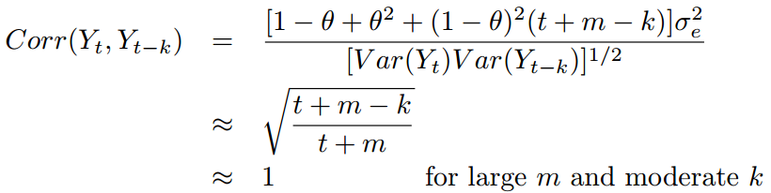
5.2 ARIMA Models
From Eq. (5.2.6), we can deduce that
and
It can be seen that as t increases, Var(Y_{t}) increases and could be quite large. Also, the correlation between Y_{t} and Y_{t−k} will be strongly positive for many lags k = 1, 2, … .

Slide 24
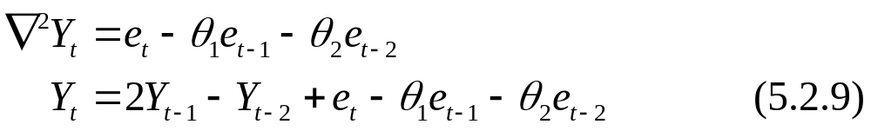
5.2 ARIMA Models
The IMA(2, 2) Model
The difference equation form of the IMA(2, 2) model is given by
From Eq. (5.2.4), Y_{t} can be expressed in terms of
e_{t}, e_{t–1} , …

Slide 25
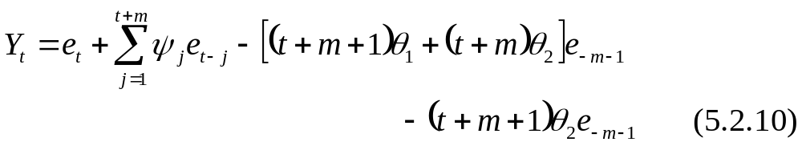
5.2 ARIMA Models
where ψ_{j} = 1 + θ₂ + (1 – θ₁ – θ₂)j for j = 1, 2, 3, …, t + m.
From (5.2.10), the ψ–weight do not die out but form a linear function of j.
Var(Y_{t}) increases rapidly with t and Corr(Y_{t}, Y_{t–k}) is nearly 1 for all moderate k. (The detailed proofs are not required and hence omitted.)

Slide 26
5.2 ARIMA Models
Exhibit 5.5 shows that the smooth change in the process values and demonstrate the facts that increasing variance and the strong, positive neighboring correlations.
Exhibit 5.6 and 5.7 show the first and second difference of the simulated series. Just to recall that, the first difference of the IMA(2, 2) series is nonstationary while the second difference is stationary.

Slide 27
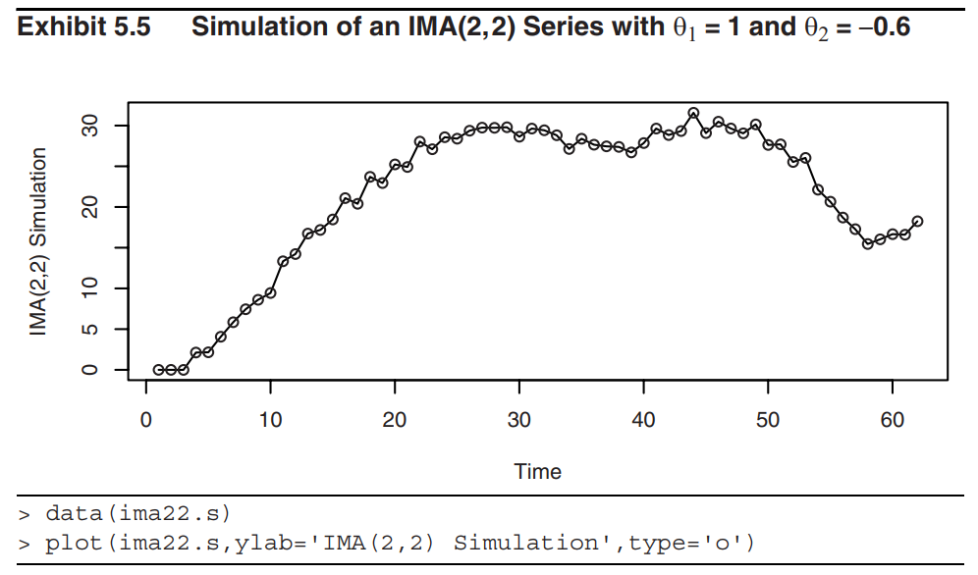
5.2 ARIMA Models

Slide 28
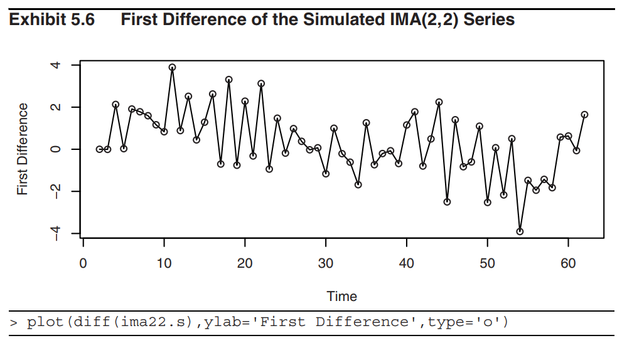
5.2 ARIMA Models

Slide 29
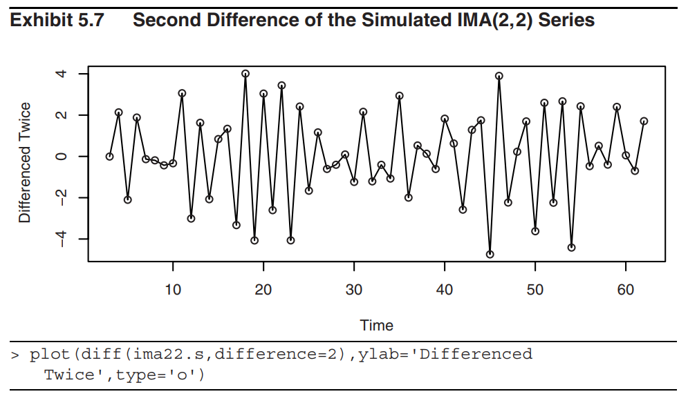
5.2 ARIMA Models

Slide 30
5.2 ARIMA Models
The ARI(1, 1) Model
The ARI(1, 1) process will satisfy
or
where |φ | < 1.
Definition
The backshift operator, denoted B, operates on the time index of a series and shifts time back one time unit to form a new series. In particular,
BY_{t} = Y_{t−1} (5.2.13)

Slide 31


5.2 ARIMA Models
Property of B:
For any constants a, b, c and series Y_{t} and X_{t}, we have
Linear:
Iterative formula: B^{n} Y_{t} = B(B^{n – 1} Y_{t} )
In terms of B, ARIMA(p, d, q) model can be expressed as
where

Slide 32
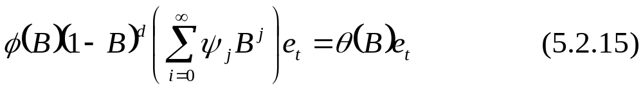
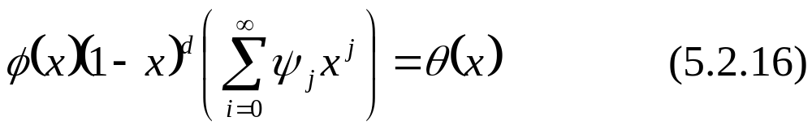
5.2 ARIMA Models
Assume that Y_{t} can be expressed in the general linear process (4.1.1). (5.2.14) can be rewritten as
where ψ₀ = 1.
The ψ-weights can be obtained by equating the power of x in the identity:

Slide 33
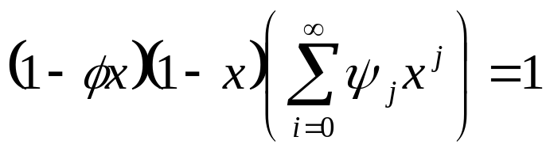
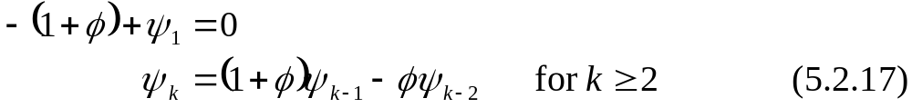
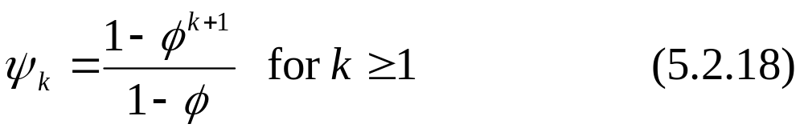
5.2 ARIMA Models
In the case of ARI(1, 1) model, Eq. (5.2.16) will be
We obtain
with ψ₀ = 1.
The explicit solution of Eq. (5.2.17) is given as

Slide 34

5.3 Constant Terms in ARIMA Models
A nonzero constant mean, μ, in a stationary ARMA model {W_{t}} can be accommodated in either of two methods:
Method 1
Method 2

Slide 35
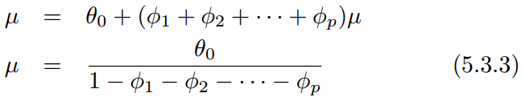
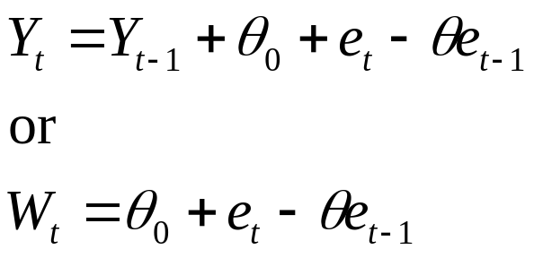
5.3 Constant Terms in ARIMA Models
Taking expected values on both sides Eq. (5.3.2), we find that
Consider the IMA(1, 1) case with a constant term. We have

Slide 36



5.3 Constant Terms in ARIMA Models
By substituting Eq. (5.2.3) , we find that
Comparing with Eq. (5.2.6), we see that we have an added linear deterministic time trend (t + m +1)θ₀ with slope θ₀.
Eq. (5.3.4) can be expressed equivalently as
where is an IMA(1, 1) series with

Slide 37
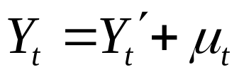

5.3 Constant Terms in ARIMA Models
For a general ARIMA(p, d, q) model where E(∇^{d}Y_{t}) ≠ 0, it can be shown that
where μ_{t} is a deterministic polynomial of degree d and is ARIMA(p, d, q) with . With d = 2 and θ₀ ≠ 0, a quadratic trend would be implied.

Slide 38
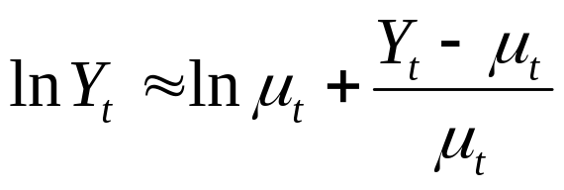
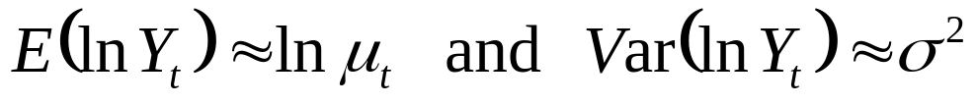
5.4 Other Transformations
Suppose that Y_{t} > 0 for all t and that
The Taylor expansion of Y_{t} gives
Taking expected values and variances of both sides of the expansion, we find that

Slide 39
5.4 Other Transformations
If the standard deviation of the series is proportional to the level of the series, then transforming to logarithms will produce a series with approximately constant variance over time.
Also, if the level of the series is changing roughly exponentially, the log-transformed series will exhibit a linear time trend. Thus, we might then want to take first differences.

Slide 40
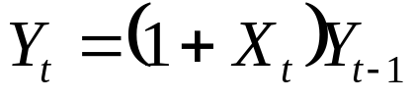
5.4 Other Transformations
Percentage Changes and Logarithms
Suppose Y_{t} tends to have relatively stable percentage changes from one time period to the next. Specifically, assume that
where 100X_{t} is the percentage change (possibly negative) from Y_{t−1} to Y_{t}.

Slide 41
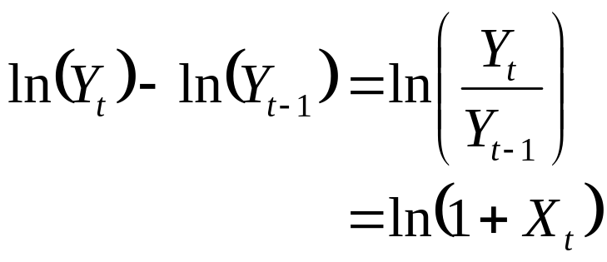
5.4 Other Transformations
If X_{t} is restricted to, say | X_{t} | < 0.2, then, to a good approximation, ln(1 + X_{t}) ≈ X_{t}. Consequently,
will be relatively stable and perhaps well-modeled by a stationary process.
In financial literature, the differences of the natural logarithms are usually called returns.

Slide 42
5.4 Other Transformations
Exhibit 5.8 shows the time series which gives the total monthly electricity generated in the U.S. in millions kilowatt-hours. The higher values display considerably more variation than the lower values.
The differences of the logarithms of the electricity values are displayed in Exhibit 5.10.

Slide 43
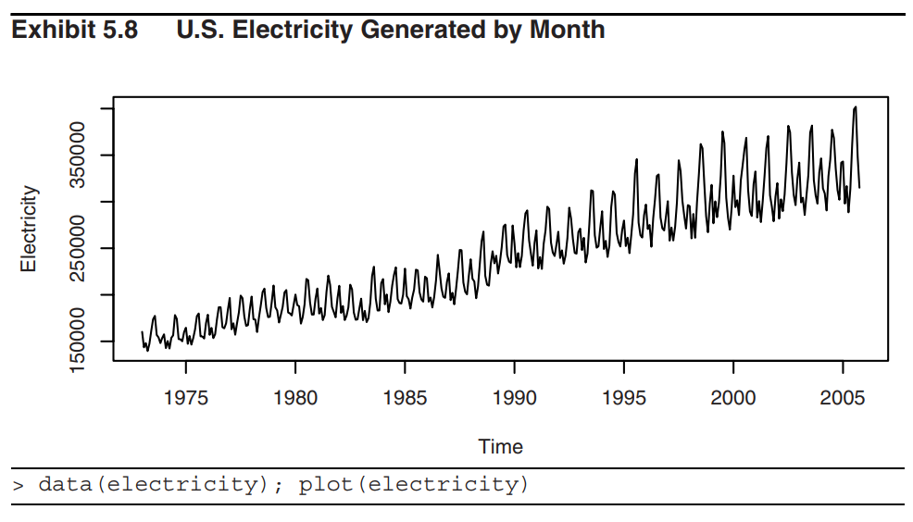
5.4 Other Transformations

Slide 44
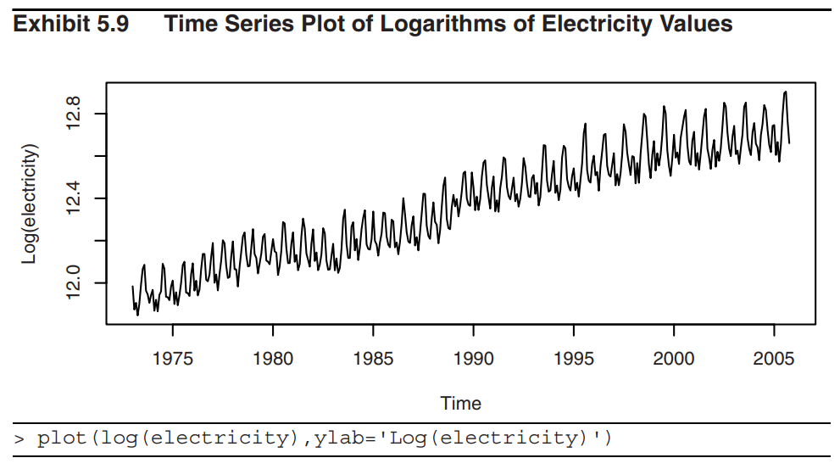
5.4 Other Transformations

Slide 45
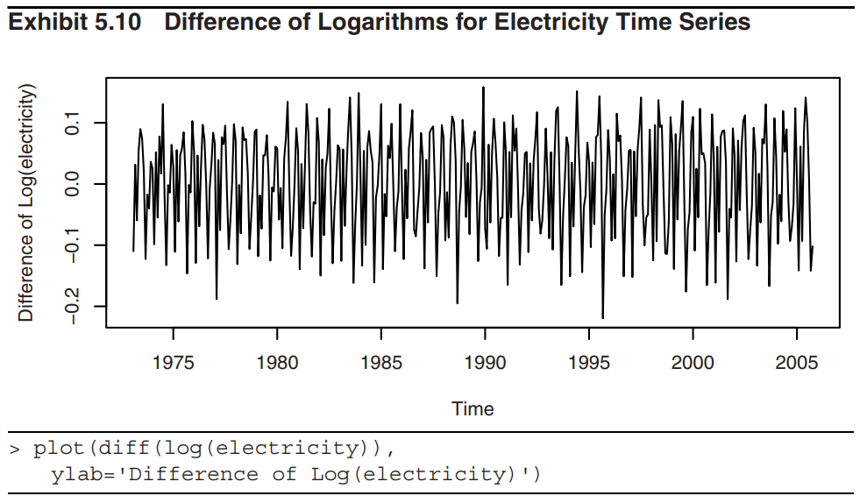
5.4 Other Transformations

Slide 46
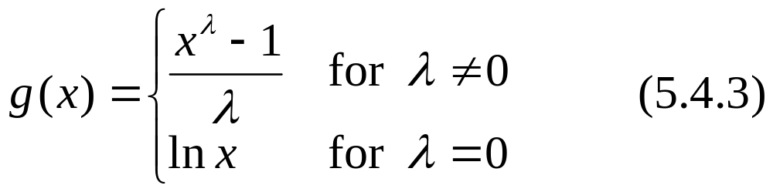
5.4 Other Transformations
Power Transformations (Box and Cox (1964))
For a given value of the parameter λ, the power transformation, for all x > 0, is defined by
λ = ½ produces a square root transformation.
λ = –1 produces a reciprocal transformation.
The power transformation applies only to positive data values. If some of the value are negative or zero, a positive constant may be added to all of the values to make them all positive before doing the transformation.

Slide 47
5.4 Other Transformations
Software allows us to consider a range of lambda values and calculate a log-likelihood value for each lambda based on a normal likelihood function.
A plot of these values is shown in Exhibit 5.11 for the electricity data. The 95% confidence interval contains the value of λ = 0 quite near its center and strongly suggests a logarithmic transformation (λ = 0) for these data.

Slide 48
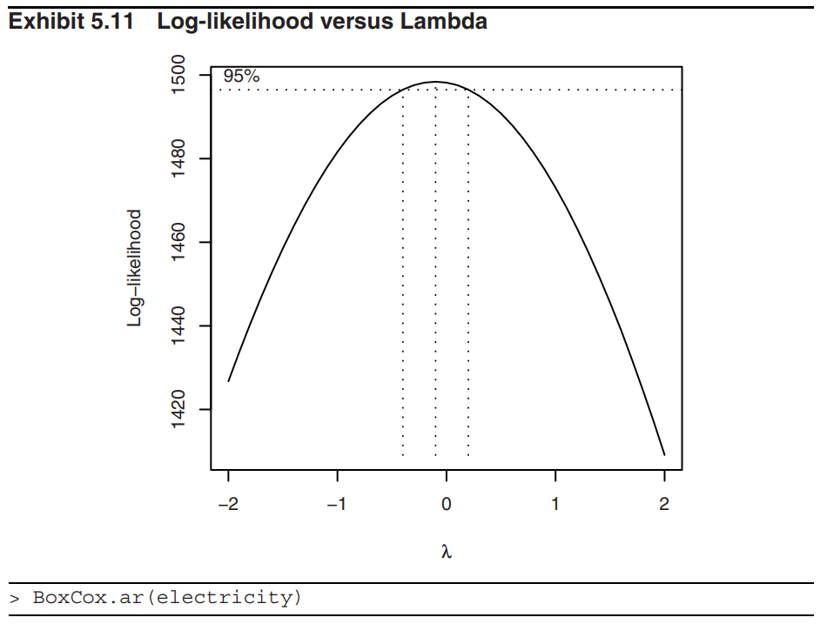
5.4 Other Transformations

Slide 49

Summary
Remove nonstationarity through differencing
ARIMA models
  ARIMA(p,d,q)
    p: order of AR; d: order of integration; q: order of MA
  Backshift operator: B
    BY_{t} = Y_{t−1}
    Linear:
    Iterative formula: B^{n} Y_{t} = B(B^{n – 1} Y_{t} )
  ARIMA model in terms of backshift operator
where

Slide 50


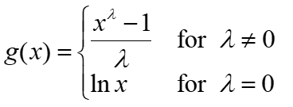
Summary
Constant terms
Other transformations
  Differences of the natural logs: usually called returns
  Power transformation

